Slide 1
Meteorites Fallen to Earth
By Olivia Bedford and Christopher Sharber
Project 1

Slide 2
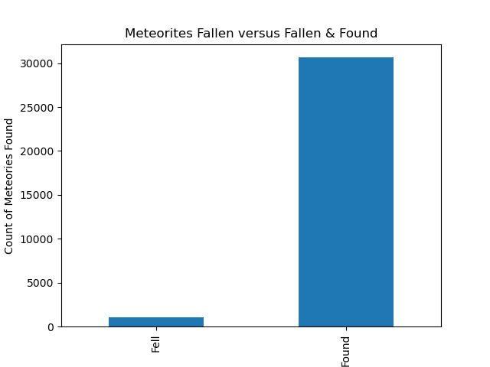
How does the geographical distribution of observed falls differ from that of found meteorites?
Notes:
To start with answering this question we plotted the fallen versus the fallen and found meteorites. There are significantly more fall and found meteorite material than those that are just observed as falling. We then wanted to see geographically where the meteorites were recorded as falling by using a geographic plot of all the Thirty One Thousand records of fallen and found meteorites.

Slide 3
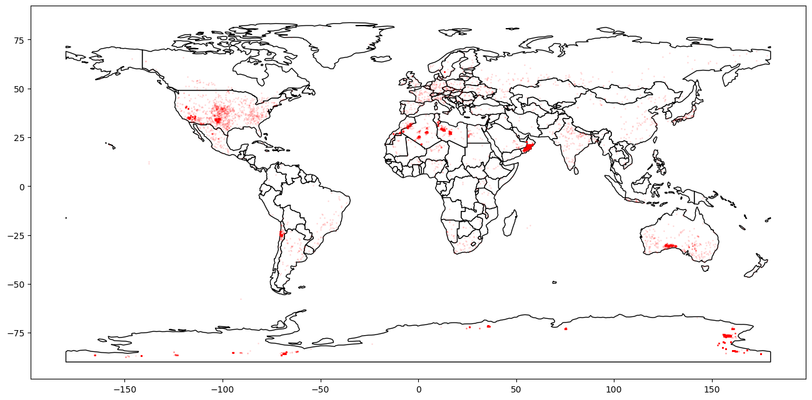
What is the proximity of meteorites fallen to major city?
Notes:
We use the geomap again to visualize the impact site, we were attempting to use the geoapify to capture proximity of the site to the recorded meteorite latitude and longitude.
We tried to perform this on 500 of the recorded locations. However, using the geographic we could get an idea of where these meteorites observations and finds where and how close they are to major cities.

Slide 4
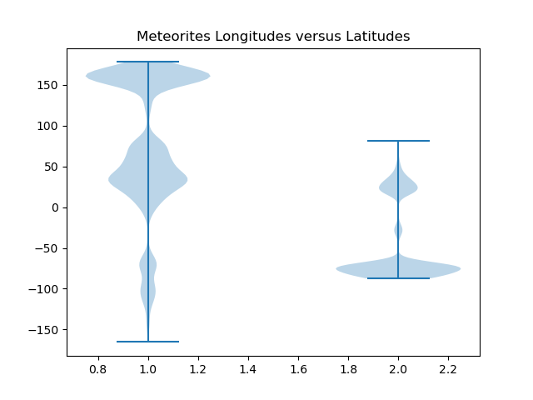
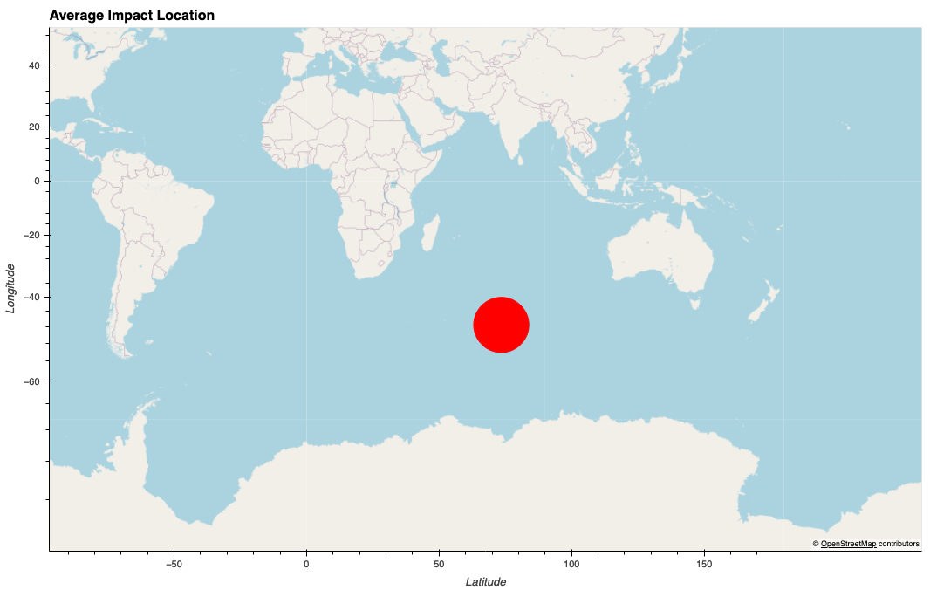
What is the most impacted or frequently impacted meteorite locations?
Notes:
We started by observing the latitude and longitude of meteorites fallen. We created a plot of impact sites that were greater than 500. Then plotted this on a geographical map. These were the top six impact sites for meteorites and yes, they are in Antarctica.
We performed further analyses on the data by creating a violin plots one for latitude and the other for longitude. These are both separate independent graphics, but they do show the number of latitudes with recorded meteorites in a specific region the same goes for the longitude of the meteorite.
We can observe that there are a significant amount of latitudes observations in the -50 to -75. This indicates Antarctica on a latitude basis and seems to align with our top 6 impact locations.

Slide 5
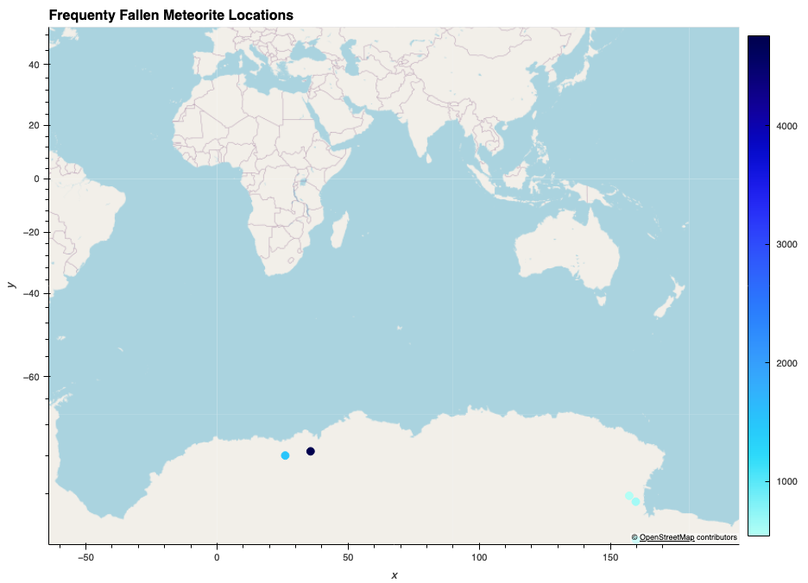
Notes:
These were the most frequently impact points for meteorites.

Slide 6
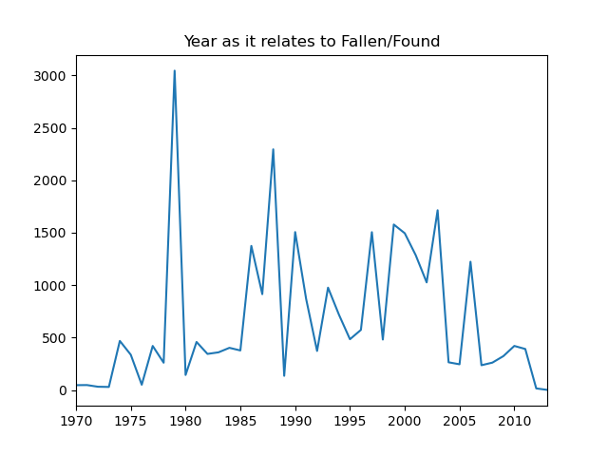
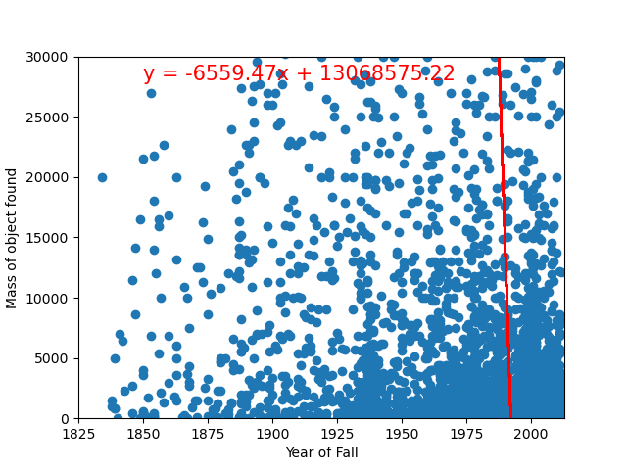
How does the year of observation compare with the fall of meteorites?
Notes:
We chose to go with a scatter plot here to determine if there was any relationship between year and fallen observation of the meteorite.
We don’t see that there is much of a relationship, but we do see that their are significantly more observation of meteorites as the years progress. Between 1978 and 1980, during the initiation of the “War on Drugs”,we see a significant level of observation. Just another possible area of relation.

Slide 7
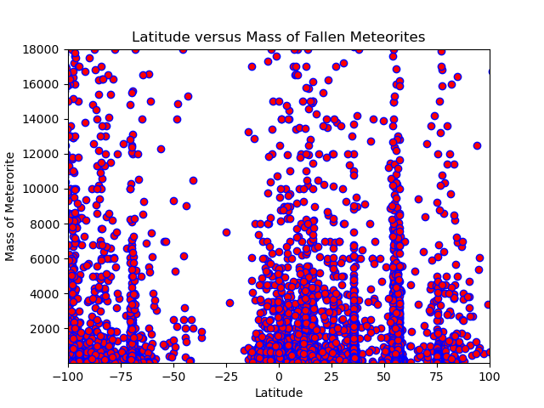

How does the Northern and the Southern Hemispheres compare to meteorite mass of fallen meteorites?
Notes:
We also wanted to see if there was any relation between the latitude and mass of the meteorite. We plotted this on a scatter plot and didn’t see any linear regression. We tried this with longitude and had the same results. We were looking for the possibility of the more massive the object the higher the gravitational pull toward a specific latitude or longitude.

Slide 8
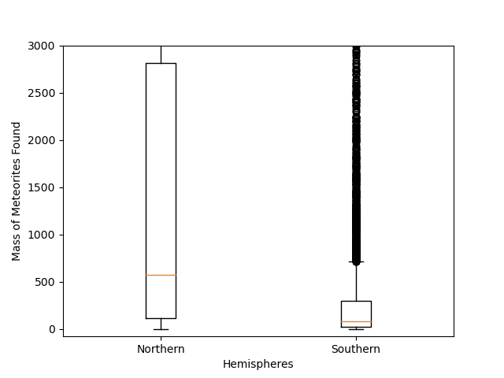
Notes:
We also use a box plot to help with analyzing the Northern hemisphere versus the Southern hemisphere. We thought that maybe the one hemisphere would have more massive meteorites than than the other.
Our box plot did show that the northern hemisphere had a median greater than the southern hemisphere as it relates to mass of the meteorite. The interquartile range of the Northern Hemisphere was indicating 1897 in comparison to the IQR of 54.54 for the Southern Hemisphere.

Slide 9
Conclusions:
meteorites are found mostly in northwestern latitudes, with several hotspots on coastlines and in the middle of the ocean, possibly due to optimal barometric conditions?
mass has no relationship to the geographic location of found or fallen meteorites, although the average mass of northern hemisphere meteorites is slightly higher than southern hemisphere meteorites. there could be a few reasons for this.
more meteorites were observed falling and were recovered in the 1960's and onward with the expansion of NASA and available technology

